Slide 1
UNIT I
NATURAL RESOURCES

Slide 2
RESOURCE
What is the value of the resource and where does it originate?
Who uses it most intensively and how?
How is it being overused or misused?
Who is responsible for its improper use-the resource collector, the middle man, the end-user?
How can we help to conserve it and prevent its unsustainable use
Notes:
Water evaporated from the hydrosphere (the seas and freshwater ecosystems), forms clouds in the atmosphere. This becomes rain, which provides moisture for the lithosphere, on which life depends. The rain also acts on rocks as an agent of erosion and over millions of years has created soil, on which plant life grows. Atmospheric movements in the form of wind, break down rocks into soil. The most sensitive and complex linkages are those between the atmosphere, the hydrosphere and the lithosphere on the one hand, with the millions of living organisms in the biosphere on the other.

Slide 3
INTRODUCTION
The natural resources include, air, water, soil, minerals, along with the climate and solar energy, which form the non-living or ‘abiotic’ part of nature.
The ‘biotic’ or living parts of nature consists of plants and animals, including microbes.
Plants and animals can only survive as communities of different organisms, all closely linked to each in their own habitat, and requiring specific abiotic conditions.
Thus, forests, grasslands, deserts, mountains, rivers, lakes and the marine environment all form habitats for specialized communities of plants and animals to live in. Interactions between the abiotic aspects of nature and specific living organisms together form ecosystems of various types.

Slide 4
FOREST RESOURCES
Any material which can be transformed in a way that it becomes more valuable and useful can be termed as resource. In other words, it is possible to obtain valuable items from any resources. Resource, therefore, are the means to attain given ends.
The aspect of satisfaction is so important that we consider a thing or substance a resource, as so long it meets our needs. Life on this planet depends upon a large number of things and services provided by the nature, which are known as Natural Resources. Thus water, air, soil, minerals, coal, forests, crops and wild life are all examples of natural resources.
Depending upon availability of natural resources can be divided into two categories such as (1) Renewable and (2) Non renewable resources.
Notes:
Resources can also be classified as biotic or abiotic. a)Biotic resources These are living resources (e.g. forest, agriculture, fish and wild life) that are able to reproduce or replace them and to increase. b)Abiotic resources These are non-living resources (e.g. petrol, land, minerals etc.) that are not able to replace themselves or do so at such a slow rate that they are not useful to consider them in terms of the human life times.

Slide 5
FOREST RESOURCES
Forest is important renewable resources. Forest vary in composition and diversity and can contribute substantially to the economic development of any country .Plants along with trees cover large areas, produce variety of products and provide food for living organisms, and also important to save the environment.
It is estimated that about 30% of world area is covered by forest whereas 26% by pastures. Among all continents, Africa has largest forested area (33%) followed by Latin America (25%), whereas in North America forest cover is only 11%. Asia and former USSR has 14% area under forest.
European countries have only 3% area under forest cover. India’s Forest Cover accounts for 20.6% of the total geographical area of the country as of 2005.

Slide 6
FOREST RESOURCES
Significance of forests Forest can provide prosperity of human being and to the nations. Important uses of forest can be classified as under
Commercial values
Ecological significance
Aesthetic values
Life and economy of tribal
Over exploitation of forests
Forests contribute substantially to the national economy. With increasing population increased demand of fuel wood, expansion of area under urban development and industries has lead to over exploitation of forest .At present international level we are losing forest at the rate of 1.7 crore hectares annually. Overexploitation also occurs due to overgrazing and conversion of forest to pastures for domestic use.
Notes:
Commercial values Forests are main source of many commercial products such as wood, timber, pulpwood etc. About 1.5 billion people depend upon fuel wood as an energy source. Timber obtained from the forest can used to make plywood, board, doors and windows, furniture, and agriculture implements and sports goods. Timber is also a raw material for preparation of paper, rayon and film.
Forest can provide food , fibre, edible oils and drugs.
Forest lands are also used for agriculture and grazing.
Forest is important source of development of dams, recreation and mining.
Life and economy of tribal
Forest provide food, medicine and other products needed for tribal people and play a vital role in the life and economy of tribes living in the forest. Ecological uses Forests are habitat to all wild animals, plants and support millions of species. They help in reducing global warming caused by green house gases and produces oxygen upon photosynthesis. Forest can act as pollution purifier by absorbing toxic gases. Forest not only helps in soil conservation but also helps to regulate the hydrological cycle. Aesthetic values All over the world people appreciate the beauty and tranquillity of the forest because forests have a greatest aesthetic value. Forest provides opportunity for recreation and ecosystem research.

Slide 7
CAUSES OF DEFORESTATION
Shifting cultivation or jhum cultivation
Commercial logging
Need for fuel wood
Expansion for agribusiness
Development projects and growing need for food
Raw materials for industrial use
Major effects of deforestation Deforestation adversely and directly affects and damages the environment and living beings .Major causes of deforestation are Soil erosion and loss of soil fertility
Decrease of rain fall due to affect of hydrological cycle
Expansion of deserts
Climate change and depletion of water table
Loss of biodiversity ,flora and fauna
Environmental changes and disturbance in forest ecosystems

Slide 8
RENEWABLE AND NON-RENEWABLE RESOURCES
Nonrenewable energy resources, like coal, nuclear, oil, and natural gas, are available in limited supplies. This is usually due to the long time it takes for them to be replenished.
Renewable resources are replenished naturally and over relatively short periods of time. The five major renewable energy resources are solar, wind, water (hydro), biomass, and geothermal.
Natural resources and associated problems
The unequal consumption of natural resources
Planning Land use
The need for sustainable lifestyles
Notes:
Since the dawn of humanity people have used renewable sources of energy to survive — wood for cooking and heating, wind and water for milling grain, and solar for lighting fires. A little more than 150 years ago people created the technology to extract energy from the ancient fossilized remains of plants and animals. These super-rich but limited sources of energy (coal, oil, and natural gas) quickly replaced wood, wind, solar, and water as the main sources of fuel.
Fossil fuels make up a large portion of today’s energy market, although promising new renewable technologies are emerging. Careers in both the renewable and nonrenewable energy industries are growing; however, there are differences between the two sectors. They each have benefits and challenges, and relate to unique technologies that play a role in our current energy system. For a range of reasons, from the limited amount of fossil fuels available to their effects on the environment, there is increased interest in using renewable forms of energy and developing technologies to increase their efficiency. This growing industry calls for a new workforce.
The need for sustainable lifestyles: The quality of human life and the quality of ecosystems on earth are indicators of the sustainable use of resources. There are clear indicators of sustainable lifestyles in human life.
• Increased longevity
• An increase in knowledge
• An enhancement of income.
These three together are known as the ‘Human development index’.
The quality of the ecosystems have indicators that are more difficult to assess.
• A stabilized population.
• The long term conservation of biodiversity.
• The careful long-term use of natural resources.
• The prevention of degradation and pollution of the environment.

Slide 9
WORDS TO KNOW
CLEAR-CUT: A parcel of forest that has been denuded of trees. Clear-cutting can be destructive of forests, particularly when the cycle of reforestation is slow and the processes of wind and water erosion of deforested land make it inhospitable to reforestation. However it can also be a tool for increasing the biodiversity of forests that have been protected from forest fires for many years.
DEFORESTATION: A reduction in the area of a forest resulting from human activity.
ECOLOGICAL SERVICES: The benefits to human communities that stem from healthy forest ecosystems, such as clean water, stable soil, and clean air.
FOREST MONOCULTURE: The development of a forest that is dominated by a single species of tree and which lacks the ecological diversity to withstand disease and parasites over the long term.
SUSTAINABILITY: Practices that preserve the balance between human needs and the environment, as well as between current and future human requirements.

Slide 10
MAJOR EFFECTS OF MINING OPERATIONS ON FOREST AND TRIBAL PEOPLE
Mining from shallow deposits is done by surface mining while that from deep deposits is done by sub-surface mining. It leads to degradation of lands and loss of top soil. It is estimated that about eighty thousands hectare land is under stress of mining activities in India.
Mining leads to drying up perennial sources of water sources like spring and streams in mountainous area.
Mining and other associated activities remove vegetation along with underlying soil mantle, which results in destruction of topography and landscape in the area. Large scale deforestation has been reported in Mussorie and Dehradun valley due to indiscriminating mining.
The forested area has declined at an average rate of 33% and the increase in non-forest area due to mining activities has resulted in relatively unstable zones leading to landslides.

Slide 11
Indiscriminate mining in forests of Goa since 1961 has destroyed more than 50000 ha of forest land. Coal mining in Jharia, Raniganj and Singrauli areas has caused extensive deforestation in Jharkhand.
Mining of magnetite and soapstone have destroyed 14 ha of forest in hilly slopes of Khirakot, Kosi valley and Almora.
Mining of radioactive minerals in Kerala, Tamilnadu and Karnataka are posing similar threats of deforestation.
The rich forests of Western Ghats are also facing the same threat due to mining projects for excavation of copper, chromites, bauxite and magnetite.

Slide 12
EFFECTS OF DAMS ON FORESTS AND TRIBAL PEOPLE
Pandit Jawaharlal Nehru referred dam and valley projects as “Temples of modern India”. These big dams and rivers valley projects have multi-purpose uses.
However, these dams are also responsible for the destruction of forests. They are responsible for degradation of catchment areas, loss of flora and fauna, increase of water borne diseases, disturbance in forest ecosystems, rehabilitation and resettlement of tribal peoples.
India has more than 1550 large dams, the maximum being in the state of Maharashtra (more than 600), followed by Gujarat (more than 250) and Madhya Pradesh (130).
The highest one is Tehri dam, on river Bhagirathi in Uttaranchal and the largest in terms of capacity is Bhakra dam on river Satluj in Himachal Pradesh. Big dams have been in sharp focus of various environmental groups all over the world, which is mainly because of several ecological problems including deforestation and socio-economic problems related to tribal or native people associated with them.

Slide 13
The Silent valley hydroelectric project was one of the first such projects situated in the tropical rain forest area of Western Ghats which attracted much concern of the people.
The crusade against the ecological damage and deforestation caused due to Tehri dam was led by Shri. Sunder Lal Bahaguna, the leader of Chipko Movement.
The cause of Sardar Sarovar Dam related issues have been taken up by the environmental activities Medha Patkar, joined by Arundhati Ray and Baba Amte. For building big dams, large scale devastation of forests takes place which breaks the natural ecological balance of the region.
Floods, droughts and landslides become more prevalent in such areas. Forests are the repositories of invaluable gifts of nature in the form of biodiversity and by destroying them (particularly, the tropical rain forests), we are going to lose these species even before knowing them. These species could be having marvellous economic or medicinal value and deforestation results in loss of this storehouse of species which have evolved over millions of years in a single stroke

Slide 14

ACTIVITY
Chipko Movement
https://en.wikipedia.org/wiki/Chipko_movement

Slide 15
FOREST CONSERVATION AND MANAGEMENT
Forest is one of the most valuable resources and thus needs to be conserved. To conserve forest, following steps should be taken. Conservation of forest is a national problem, thus it should be tackled with perfect coordination between concerned government departments.
People should be made aware of importance of forest and involved in forest conservation activities.
The cutting of trees in the forests for timber should be stopped.
A forestation programs should be launched
Grasslands should be regenerated.
Forest conservation Act should be strictly implemented to check deforestation.
Awards should be instituted for the deserving.

Slide 16
WATER RESOURCES
Water is an indispensable resource for life on earth. Approximately 70.8 % surface of earth is covered with water in the form of oceans. Out of this, about 97% is not fit for human consumption, about 2% is locked as a glacier and only less than 1% available as fresh water that can be used for human consumption and other uses.
Water is a very important source and essential for life because it has very unique characteristic such as
Water exists as liquid over a wide range of temperature 0-100⁰C with highest specific heat and latent heat of vaporization.
Water is excellent solvent and act as carrier of nutrient and helps to distribute them to the cells in the body, regulates the body temperature and support structure and can dissolve various pollutant and can act as carrier of large number of microorganisms
It is responsible for hydrological cycle which acts as resource of water to the earth. It is estimated that about 1.4 inch thick layer of water evaporates and majority of water returns to earth through hydrological cycle.

Slide 17
WATER RESOURCES
Water Use
More than 99% of earth water is unavailable for use; only 1% water is available for people, animal, plants and earth. There is an uneven distribution of water resources, tropical rain forest are receive maximum rainfall where as desert receive only little rainfall.
Due to its unique properties water is of multiple uses for all living organisms. Water is absolutely essential for all the living organisms. One can survive for weeks without food but cannot survive more than a few days without water. Since the earliest days of mankind water availability was the major factor to decide the place of human settlements. Water dissolves nutrients and distributes them in different parts of plants and regulates the temperature and removes the waste.

Slide 18
Fresh water crisis
On global scale water availability is not a problem itself, but it’s availability in right form, right time and right place is a problem. Irregularities in duration and intensity of rainfall cause floods and droughts. Out of the total water reserves of the world, about 97% is salty water (marine) and only 3% is fresh water.
Due to increased demands overuse of groundwater for drinking, irrigation and domestic purposes has lead to rapid depletion of groundwater in various regions leading to lowering of water table.
Pollution of many of the groundwater aquifers has made them unfit for consumption. Rivers and streams have long been used for discharging the wastes. due to industrialization river water are being polluted because industrial residues are pushed into the river .Civilizations have grown and flourished on the banks of rivers, but being over populated due to fast growth are polluting the natural resources of water.

Slide 19
PROBLEMS ASSOCIATED WITH WATER RESOURCES
These are some problems associated with use of water
Water Scarcity (precipitation/evapotranspiration balance, temporal availability, per capita availability)
Floods and droughts (spatio-temporal distribution; regular floods related to heavy winter or spring rains, increasing damage level due to shifting land use (settlements in flood zones) recurrent summer droughts coinciding with peak demand periods for agriculture and tourism)
Groundwater availability and quality (aquifer size and access, yield, saltwater intrusion, pollution of shallow aquifers)
Watershed degradation (deforestation, land use, increasing impervious (sealed) areas due to urbanization the main concern here is land use change (primarily deforestation and urbanization) and its effects on runoff patterns (flooding) and water quality including erosion/sediments with subsequent problems such as reservoir siltation/capacity loss)
Coastal interaction (salinity intrusion in groundwater and estuaries, coastal pollution due to pollution runoff)

Slide 20
OVER-EXPLOITATION OF WATER
Groundwater About 9.86% of the total fresh water resources are in the form of groundwater and it is about 35-50 times that of surface water supplies.
Effects of extensive and reckless groundwater usage:
1. Subsidence
2. Lowering of water table
3. Water logging
Surface water
Surface water mainly comes directly from rain or snow covers. The various surface sources are natural lakes and ponds, rivers and streams, artificial reservoirs. Availability of surface water decides the economy of the country. On one side surface water availability affects the productivity, but on the other side water sources may cause floods and drought. Due to unequal distribution, water may lead to national (interstate) or international disputes.

Slide 21
MAJOR WATER CONFLICTS
Some of the major water conflicts that have become thorn in relations between states and countries are
Water conflict in the middle east
Countries involved are Sudan, Egypt and Turkey. It also affects countries which are water starved viz. Saudi Arabia, Kuwait, Syria, Israel and Jordan.
The Indus water treaty
This Indus water treaty dispute between India and Pakistan is lingering since long.
The Cauvery water dispute
It involves two major states of India viz. Tamilnadu and Karnataka.
The Satluj-Yamuna link canal dispute
The dispute is between two Northern states viz. Punjab and Haryana and UP, Rajasthan as well as Delhi has also interest in it .
In traditional water management, innovative arrangements ensure equitable distribution of water, which are democratically implemented. These disputes can be solved amicably through ‘Gram Panchayats”, if transparency is maintained. But disputes between countries or states sometimes attain war like situation and are difficult to solve.

Slide 22
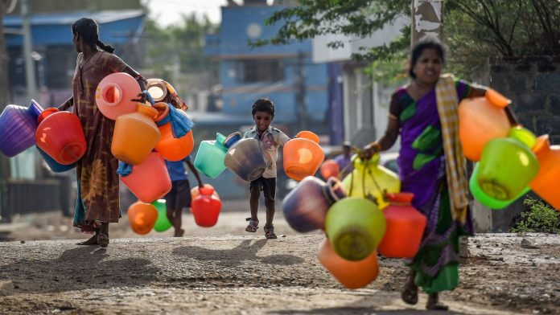
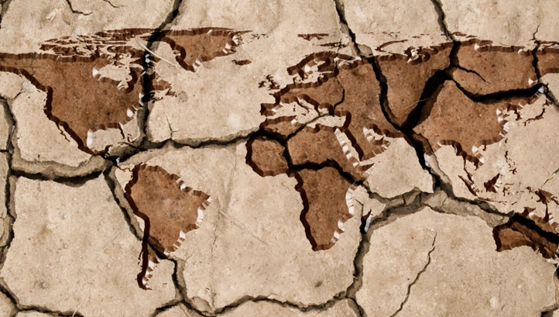
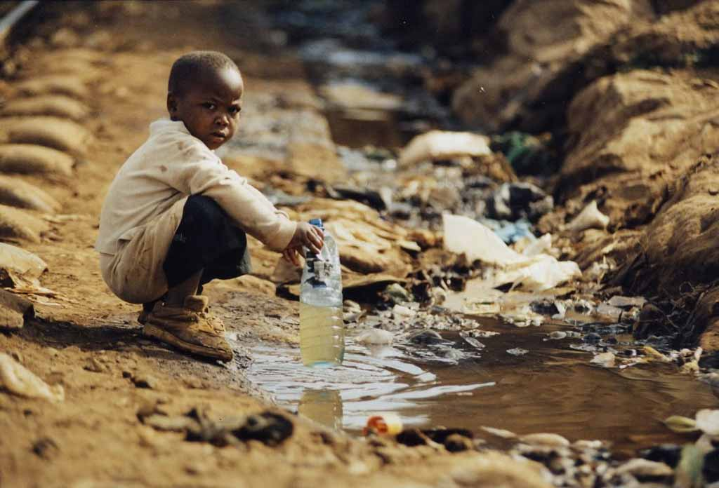
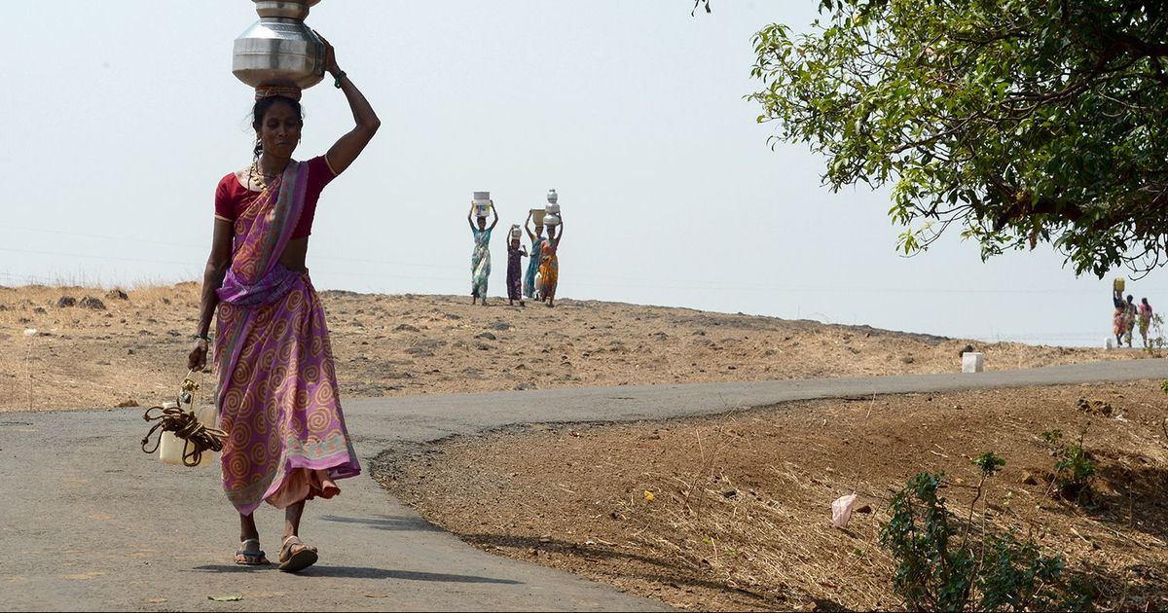

Slide 23
DAMS - BENEFITS AND PROBLEMS
Water is a precious resource and its scarcity is increasing at global level. There is a pressure to utilize surface water resources efficiently for different purposes. According to World Commission on Dam Report -2001 there are 45000 large dams spread over 140 countries
Major benefits of dam
Hydroelectricity generation
Year round water supply to ensure higher productivity
Equal water distribution by transferring water from area of excess to area of deficit
Helps flood control and protects soil
Assure irrigation during dry periods
River valley projects provide inland water navigation ,employment opportunities and can be used to develop fish hatcheries and nurseries
River valley projects have tremendous potential for economic upliftment and will help to raise the standard of living and can help to improve the quality of life

Slide 24
DISADVANTAGES/PROBLEMS OF DAMS
Although dams have proved very useful over the centuries but recent past big dams has created lot of human as well as environmental issues
1. Submergence of large areas may lead to loss of fertile soil and displacement of tribal people
2. Salt left behind due to evaporation increase the salinity of river water and makes it unusable when reaches down stream
3. Siltation and sedimentation of reservoirs not only makes dams use less but also is responsible for loss of valuable nutrients
4. Loss of non-forest land leads to loss of flora and fauna
5. Changes in fisheries and the spawning grounds
6. Stagnation and water logging near reservoir leads to breeding of vectors and spread of vector-borne diseases
7. Growth of aquatic weeds may lead to microclimatic changes.

Slide 25
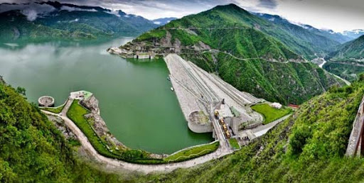
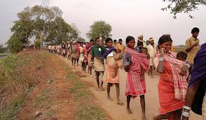
DISADVANTAGES/PROBLEMS OF DAMS

Slide 26
MINERAL RESOURCES
Minerals are essential for the formation and functioning of organisms, plant animals and human beings. In the modern era, human life needs variety of minerals to sustain industry based civilization. Mineral resources are broadly defined as elements, chemical compounds, and mixtures which are extracted to manufacture sustainable commodity. India has rich mineral resource base to provide suitable base for industrial development in the country. Sufficient reserve of nuclear energy minerals is available in India.
India’s reserves, as well as production are adequate in petroleum, ores of copper, lead, zinc, tin, graphite, mercury, tungsten, and in the minerals required for fertilizer industry such as sulphur, potassium and phosphorus.

Slide 27
EXPLOITATION OF MINERALS
Depending on their use, mineral resources can be divided into several broad categories such as elements for metal production and technology, building materials, minerals for the chemical industry and minerals for agriculture. When usually we think about mineral resources we often think of metals but the predominant mineral resources are not metallic. The picture of annual world consumption of some elements is as under:
Sodium and iron are used at a rate of about 0.1 to 1.0 billion metric tons per year.
Nitrogen, sulphur, potassium and calcium are primarily used as fertilizers at a rate of about 10 to 100 million metric tons per year.
Zinc, copper, aluminium and lead are used at a rate of about 3 to 10 million metric tons per year;
Gold and silver are used at a rate of about 10 thousand metric tons per year.
Out of all the metallic minerals, iron consumption is 95% of the metals consumedThus, with the exception of iron, the non-metallic minerals are consumed at much greater rates than the elements used for their metallic properties.

Slide 28
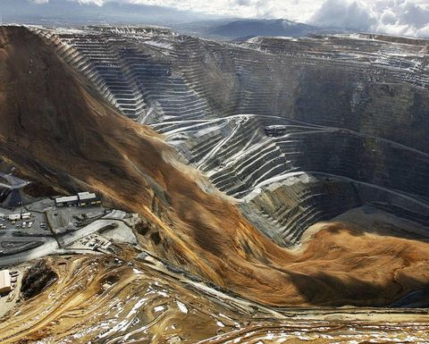
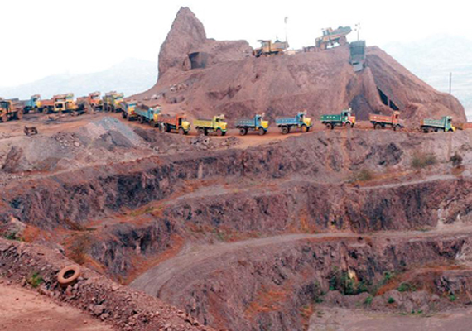
EXPLOITATION OF MINERALS

Slide 29
USES OF MINERALS
Due to increased population, there is increased demand of minerals by the industry, transport, agriculture and defense preparation. Depletion of almost all known and easily accessible deposits is anticipated in near future. Moreover, there may be shortage of some crucial elements such as mercury, tin, copper, gold, silver and platinum. The limited resource of phosphorus, which is an essential component of chemical fertilizers, is another area of concern.

Slide 30

ACTIVITY
Find the personality

Slide 31
ENVIRONMENTAL IMPACTS OF MINERAL EXTRACTION
Extracting and use of mineral resources can affect the environment adversely. Environmental affect may depend on factors such as mining procedures, ore quality, climate, size of operation, topography, etc. Some of major environmental impacts of mining and processing operations are as under
1. Degradation of land.
2. Pollution of surfaces and ground water resources.
3. Effect on growth of vegetation due to leaching out effect of minerals.
4. Surface water pollution and groundwater contamination lead to occupational health hazards etc.
5. Air pollution due to emission of gases.
6. Deforestation affects flora and fauna.
7. Rehabilitation of affected population.

Slide 32
CONSERVATION OF MINERALS
Conservation of minerals can be done in number of ways and these are as follows,
Industries can reduce waste by using more efficient mining and processing methods.
In some cases, industries can substitute plentiful materials for scarce ones.
Some mineral products can be recycled. Aluminum cans are commonly recycled. Although bauxite is plentiful, it can be expensive to refine. Recycling aluminum products does not require the large amounts of electric power needed to refine bauxite.
Products made from many other minerals, such as nickel, chromium, lead, copper, and zinc, can also be recycled.
Strict laws should be made and enforced to ensure efficient management of mining resources.

Slide 33
FOOD RESOURCES
Food is essential for growth and development of living organisms. These essential materials are called nutrients and these nutrients are available from variety of animals and plants.
There are thousands of edible plants and animals over the world, out of which only about three dozen types constitute major food of humans.
Food sources
The majority of people obtain food from cultivated plants and domesticated animals. Although some food is obtained from oceans and fresh waters, but the great majority of food for human population is obtained from traditional land-based agriculture of crops and livestock.

Slide 34
FOOD SOURCES
Food crops
Livestock
Aquaculture
World Food Problems As per estimates of Food and Agriculture Organization (FAO), about 840 million people remain chronically hungry and out of this 800 million are living in the developing world. In last decade, it is decreasing at the rate of 2.5 million per year, but at the same time world’s population is increasing. Target of cutting half the number of world’s chronically hungry and undernourished people by 2015 will difficult to meet, if the present trend continues. Due to inadequate purchasing power to buy food, it is difficult to fulfil minimum calorific requirement of human body per day. Large number of people are in India are poor which can be attribute to equitable distribution of income. Food insufficiency can be divided into two categories into under-nourishment and malnourishment. Both of these insufficiencies are global problems.
Notes:
5.1.2 Food crops
It is estimated that out of about 2,50,000 species of plants, only about 3,000 have been tried as agricultural crops. Under different agro-climatic condition, 300 are grown for food and only 100 are used on a large scale.
Some species of crops provide food, whereas others provide commercial products like oils, fibres, etc. Raw crops are sometimes converted into valuable edible products by using different techniques for value addition .At global level, only 20 species of crops are used for food. These, in approximate order of importance are wheat, rice, corn, potatoes; barley, sweet potatoes, cassavas, soybeans, oats, sorghum, millet, sugarcane, sugar beets, rye, peanuts, field beans, chick-peas, pigeon- peas, bananas and coconuts. Many of them are used directly, whereas other can be used by changing them by using different techniques for enhancing calorific value.
5.1.3 Livestock
Domesticated animals are an important food source. The major domesticated animals used as food source by human beings are ‘ruminants’ (e.g. cattle, sheep, goats, camel, reindeer, llama, etc.).
Ruminants convert indigestible woody tissue of plants (cellulose) which are earth’s most abundant organic compound into digestible food products for human consumption. Milk, which is provided by milking animals, is considered to be the complete food. Other domestic animals like sheep, goat, poultry and ducker can be used as meat.
5.1.4 Aquaculture
Fish and seafood contributes 17 million metric tonnes of high quality protein to provide balance diet to the world. Presently aquaculture provides only small amounts for world food but its significance is increasing day by day.

Slide 35
FOOD SOURCES
Under-nourishment
The FAO estimates that the average minimum daily caloric intake over the whole world is about 2,500 calories per day. People who receive less than 90% of their minimum dietary intake on a long-term basis are considered undernourished. Those who receive less than 80% of their minimum daily caloric intake requirements are considered ‘seriously’ undernourished. Children in this category are likely to suffer from stunted growth, mental retardation, and other social and developmental disorders. Therefore, Under-nourishment means lack of sufficient calories in available food, resulting in little or no ability to move or work.
Malnourishment
Person may have excess food but still diet suffers from due to nutritional imbalance or inability to absorb or may have problem to utilize essential nutrients. If we compare diet of the developed countries with developing countries people in developed countries have processed food which may be deficient in fibre, vitamins and other components where as in the diet of developing countries, may be lack of specific nutrients because they consume less meat ,fruits and vegetables due to poor purchasing power .
Malnourishment can be defined as lack of specific components of food such as proteins, vitamins, or essential chemical elements.

Slide 36
FOOD SOURCES
The major problems of malnutrition are:
Marasmus: a progressive emaciation caused by lack of protein and calories.
Kwashiarkor: a lack of sufficient protein in the diet which leads to a failure of neural development and therefore learning disabilities.
Anemia: it is caused by lack of iron in the diet or due to an inability to absorb iron from food.
Pellagra: it occurs due to the deficiency of tryptophan and lysine, vitamins in the diet.
Every year, food problem kill as many people as were killed by the atomic bomb dropped on Hiroshima during World War II. This shows that there is drastic need to increase food production, equitably distribute it and also to control population growth. Although India is the third largest producer of staple crops, it is estimated that about 300 million Indians are still undernourished. India has only half as much land as USA, but it has nearly three times population to feed. Our food problems are directly related to population.
Notes:
Balanced diet
Supply of adequate amount of different nutrient can help to improve malnutrition and its ill effects. Cereals like wheat and rice can supply only carbohydrate which are rich in energy supply, are only fraction of nutrition requirement. Cereal diet has to be supplemented with other food that can supply fat, protein and minor quantity of minerals and vitamins. Balanced diet will help to improve growth and health.

Slide 37
CHANGES CAUSED BY AGRICULTURE AND OVERGRAZING
From centuries, agriculture is providing inputs to large number of industries involved in production, processing and distribution of food. Accordingly, agriculture has significant effect on environment. The effects of agriculture on environment can be classified as local, regional, and global level. The agriculture also makes impact on the usage of land generally as follows:
Deforestation
Soil Erosion
Depletion of nutrients
Impact related to high yielding varieties (HYV)
Fertilizers related problems include micronutrient imbalance, nitrite pollution and eutrophication.

Slide 38
6.Pesticide related problems include creating resistance in pests and producing new pests, death of non-target organisms, biological magnification.
7.Some other problems include water logging, salinity problems.
The carrying capacity of land for cattle depends upon micro climate and soil fertility. If carrying capacity is exceeded than land is overgrazed. Because of overgrazing the agricultural land gets affected as follows,
Reduction in growth and diversity of plant species
Reduce plant cover leads to increased soil erosion
Cattle trampling leads to land degradation

Slide 39
EFFECTS OF MODERN AGRICULTURE
For sustainable production modern techniques are used to enhance productivity of different cropping systems under different agro-eco-zones. Adoption of modern agricultural practices has both positive and negative effects on environment. Effects of modern agriculture are briefly discussed under different heads as under:
Soil erosion
Raindrops bombarding bare soil result in the oldest and still most serious problem of agriculture. The long history of soil erosion and its impact on civilization is one of devastation. Eroded fields record our failure as land stewards.

Slide 40
EFFECTS OF MODERN AGRICULTURE
Irrigation
Adequate rainfall is never guaranteed for the dry land farmer in arid and semiarid regions, and thus irrigation is essential for reliable production. Irrigation ensures sufficient water when needed and also allows farmers to expand their acreage of suitable cropland. In fact, we rely heavily on crops from irrigated lands, with fully one-third of the world's harvest coming from that 17% of cropland that is under irrigation. Unfortunately, current irrigation practices severely damage the cropland and the aquatic systems from which the water is withdrawn.
Agriculture and the loss of genetic diversity
As modern agriculture converts an ever-increasing portion of the earth's land surface to monoculture, the genetic and ecological diversity of the planet erodes. Both the conversion of diverse natural ecosystems to new agricultural lands and the narrowing of the genetic diversity of crops contribute to this erosion.

Slide 41
EFFECTS OF MODERN AGRICULTURE
Fertilizer-pesticide problems
For photosynthesis apart from water, sunshine and CO_{2,} plants need micro and macro nutrients for growth. These nutrients are supplied in the shape of fertilizers. There is lot of potential to increase food productivity by increasing fertilizer use. On one hand application of artificial chemical fertilizers increases the productivity at faster rate as compare to organic fertilizers, on the other hand application of fertilizers can be a serious problem of pollution and can create number of problems. Excessive level of nitrates in ground water has created problems in developed countries. These are:
a. Accumulated phosphorous as a consequence of use of phosphoric fertilizer are posing serious threat as residues in domestic water supply and for ecology of river and other water bodies. Increased level of phosphates in different water results in eutrophication.
b. Effect of chemical fertilizer is long term, therefore leads to net loss of soil organic matter.

Slide 42
Cont..,
To control insects, pests, diseases and weeds which are responsible for reduction in productivity different chemicals are used as insecticides, pesticides and herbicides. Successful control of insects, pests and weeds increases productivity and reduces losses and provide security for harvest and storage. Applications of these synthetic chemicals have great economic values and at the same time cause number of serious problems such as:
a. Affects human health which includes acute poisoning and illness caused by higher doses and accidental exposes
b. As long term effect, cause cancer, birth defects, Parkinson’s disease and other regenerative diseases.
c. Long term application of pesticides can affect soil fertility.
d. Danger of killing beneficial predators.
e. Pesticides resistance and pest resurgence

Slide 43
Cont..,
Water Logging
High water table or surface flooding can cause water logging problems .Water logging may lead to poor crop productivity due to anaerobic condition created in the soil. In India, deltas of Ganga, Andaman and Nicobar Islands and some areas of Kerala are prone to frequent water logging.
Salinity
Due to adoption of intensive agriculture practices and increased concentration of soluble salts leads to salinity. Due to poor drainage, dissolved salts accumulate on soil surface and affects soil fertility. Excess concentration of these salts may form a crust on the surface which may injurious to the plants. The water absorption process is affected and uptake of nutrient is disturbed. According to an estimate, in India, 7 million hectare of land is saline and area is showing in increasing trends due to adoption of intensive agriculture practices.

Slide 44
ACTIVITY
The highest per capita emitter of Carbon dioxide in the world is :
[A] USA [B] China [C] Qatar [D] Saudi Arabia
Identify the non Green-House Gas(GHG) from the following :
[A] Methane [B] Nitrous oxide [C] Sulphur Hexafluoride [D] Carbon Monoxide

Slide 45
ENERGY RESOURCES
Growing Energy Needs Energy consumption of a nation is usually considered as an index of its development, because almost all the development activities are directly or indirectly dependent upon energy. Power generation and energy consumption are crucial to economic development as economy of any nation depends upon availability of energy resources. There are wide disparities in per capita energy use of developed and the developing nations. With increased speed of development in the developing nations energy needs are also increasing. The very original form of energy technology probably was the fire, which produced heat and the early man used it for cooking and heating purposes.
Wind and hydropower has also been used. Invention of steam engineers replaced the burning of wood by coal and coal was further replaced by oil.
The oil producing has started twisting arms of the developed as well as developing countries by dictating the prices of oil and other petroleum products.

Slide 46
ENERGY RESOURCES
Energy resources are primarily divided into two categories viz. renewable and non-renewable sources.
Renewable energy resources must be preferred over the non-renewable resources.
It is inevitable truth that now there is an urgent need of thinking in terms of alternative sources of energy, which are also termed as non-conventional energy sources which include:
Solar energy needs equipment's such as solar heat collectors, solar cells, solar cooker, solar water heater, solar furnace and solar power plants .
Wind energy
Hydropower, Tidal energy, ocean thermal energy, geothermal energy, biomass, biogas, biofuels etc.
The non renewable energy sources include coal, petroleum, natural gas, nuclear energy.

Slide 47
ENERGY SCENARIO
Energy is a key input in the economic growth and there is a close link between the availability of energy and the future growth of a nation. Power generation and energy consumption are crucial to economic development. In India, energy is consumed in a variety of forms such as fuel wood; animal waste and agricultural residues are the traditional sources of energy. These non-commercial fuels are gradually getting replaced by commercial fuels i.e. coal, petroleum products, natural gas and electricity. Out of total energy, commercial fuels account for 60% where as the balance 40% is coming from non-commercial fuels. Of the total commercial energy produced in the form of power or electricity, 69% is from coal (thermal power),
25% is from hydel power,
4% is from diesel and gas,
2% is from nuclear power, and
Less than 1% from non- conventional sources like solar, wind, ocean, biomass, etc.
Notes:
Petroleum and its products are the other large sources of energy. In a developing country like India, in spite of enhanced energy production, there is still shortage due to increased demand of energy. In spite of the fact that there is a phenomenal increase in power generating capacity, still there is 30% deficit of about 2,000 million units. Policy makers are in the process of formulating an energy policy with the objectives of ensuring adequate energy supply at a minimum cost, achieving self-sufficiency in energy supplies and protecting environment from adverse impact of utilizing energy resources in an injudicious manner. The main features of this policy are Accelerated exploitation of domestic conventional energy resources, viz., oil, coal, hydro and nuclear power;
Intensification of exploration to achieve indigenous production of oil and gas;
Efficient management of demand of oil and other forms of energy;
To formulate efficient methods of energy conservation and management;
Optimisation of utilisation of existing capacity in the country
Development and exploitation of renewable sources of energy to meet energy requirements of rural communities;
Organisation of training for personnel engaged at various levels in the energy sector.
Government private partnership to exploit natural energy resources

Slide 48
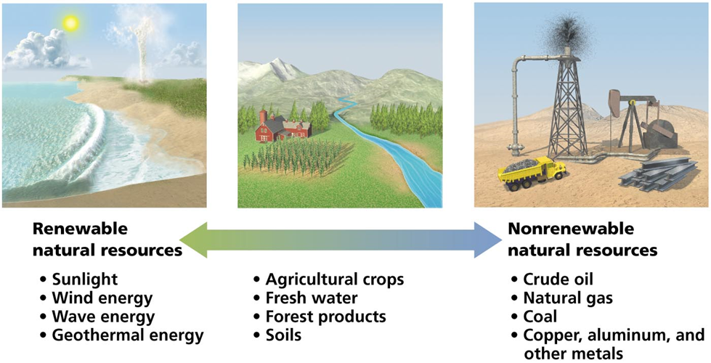
Natural resources - substances and energy sources needed for survival
Renewable resources:
Perpetually available: sunlight, wind, wave energy
Renew themselves over short periods: timber, water, soil
These can be destroyed
Non-renewable resources: can be depleted
Oil, coal, minerals

Slide 49
RENEWABLE RESOURCES
The resources that can be replenished through rapid natural cycles are known as renewable resource.
These resources are able to increase their abundance through reproduction and utilization of simple substances.
Examples of renewable resources are plants (crops and forests),and animals who are being replaced from time to time because they have the power of reproducing and maintain life cycles.
Some examples of renewable resources though they do not have life cycle but can be recycled are wood and wood-products, pulp products, natural rubber, fibres (e.g. cotton, jute, animal wool, silk and synthetic fibres) and leather.
In addition to these resources, water and soil are also classified as renewable resources. Solar energy although having a finite life, as a special case, is considered as a renewable resource in as much as solar stocks is inexhaustible on the human scale.

Slide 50
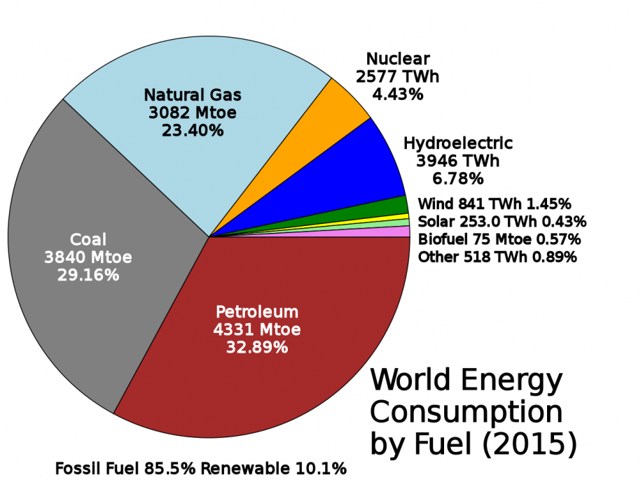
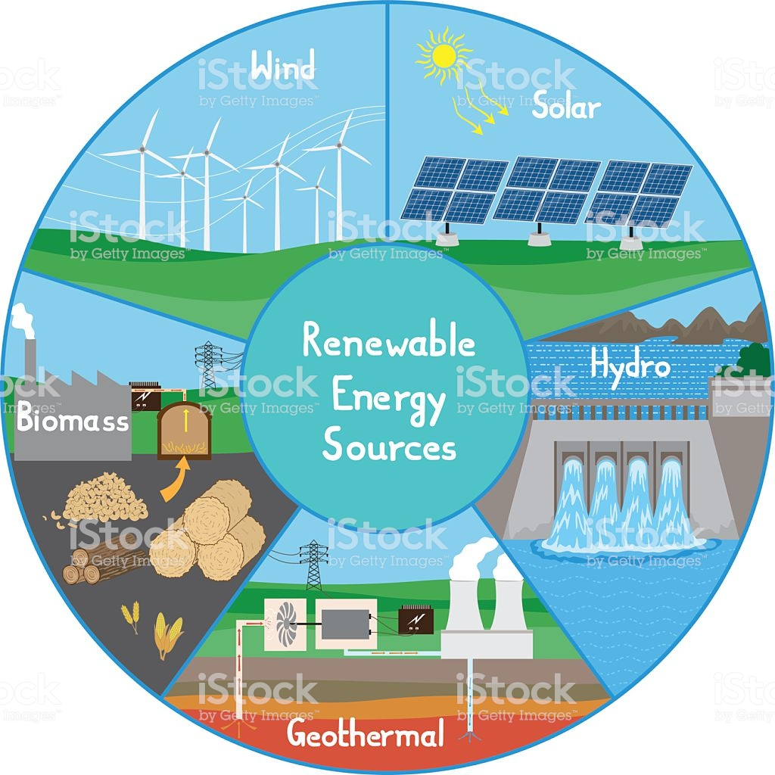
RENEWABLE RESOURCES

Slide 51
NON-RENEWABLE RESOURCES
The resources that cannot be replenished through natural processes are known as non-renewable resources.
These are available in limited amounts, which cannot be increased. These resources include fossil fuels (petrol, coal etc.), nuclear energy sources (e.g. uranium, thorium, etc). metals (iron, copper, gold, silver, lead, zinc etc.), minerals and salts (carbonates, phosphates, nitrates etc.).
Once a non-renewable resource is consumed, it is gone forever. Then we have to find a substitute for it or do without it.
Non-renewable resources can further be divided into two categories, viz. Recyclable and non-recyclable
Notes:
6.4.1 Recyclable resources These are non-renewable resources, which can be collected after they are used and can be recycled. These are mainly the non-energy mineral resources, which occur in the earth’s crust (e.g. ores of aluminium, copper, mercury etc.) and deposits of fertilizer nutrients (e.g. phosphate sock and potassium and minerals used in their natural state (asbestos, clay, mica etc.) 6.4.2 Non-recyclable resources These are non-renewable resources, which cannot be recycled in any way. Examples of these are fossil fuels and nuclear energy sources (e.g. uranium, etc) which provide 90 per cent of our energy requirements. 6.5 Use of Alternate Energy Sources There is a need to develop renewable energy sources which are available and could be utilized (solar or wind) or the sources which could be created and utilized (bio-mass). The main renewable energy sources for India are solar, wind, hydel, waste and bio-mass. Bio-mass are resources which are agriculture related like wood, bagasse, cow dung, seeds, etc. 6.5.1 Hydel energy India has a total hydro energy potential of about 1.5 lakh MW, of which only about 20 % is installed. Small hydro plant potential is about 15000 MW and most of it is in the northern and eastern hilly regions. 6.5.2 Wind energy The wind power potential of India is about 45,000 MW out of which capacity of 8748 MW has been installed in India till 2008. India is one of the leading countries in generating the power through wind energy. Gujarat, AP, Karnataka, MP and Rajasthan are states having more than 5000 MW potential each. These potentials could be improved if the technology of putting turbines in sea is embraced. There are wind farms on sea generating as high as 160 MW of power.
6.5.3 Geothermal energy Geothermal energy is thermal energy generated and stored in the Earth. Thermal energy is the energy that determines the temperature of matter. Earth's geothermal energy originates from the original formation of the planet (20%) and from radioactive decay of minerals (80%). Geothermal power is cost effective, reliable, sustainable, and environmentally friendly, but has historically been limited to areas near tectonic plate boundaries. Recent technological advances have dramatically expanded the range and size of viable resources, especially for applications such as home heating, opening a potential for widespread exploitation. Geothermal wells release greenhouse gases trapped deep within the earth, but these emissions are much lower per energy unit than those of fossil fuels. As a result, geothermal power has the potential to help mitigate global warming if widely deployed in place of fossil fuels. 6.5.4 Ocean thermal energy conversion (OTEC ) Ocean Thermal Energy Conversion (OTEC) uses the difference between cooler deep and warmer shallow or surface ocean waters to run a heat engine and produce useful work, usually in the form of electricity. A heat engine gives greater efficiency and power when run with a large temperature difference. In the oceans the temperature difference between surface and deep water is greatest in the tropics, although still a modest 20 to 25 °C. It is therefore in the tropics that OTEC offers the greatest possibilities. OTEC has the potential to offer global amounts of energy that are 10 to 100 times greater than other ocean energy options such as wave power 6.5.5 Biomass energy Biomass is the oldest means of energy used by humans along with solar energy. As soon as the fire was discovered, it was used widely among humans mainly for heat and light. Fire was generated using wood or leaves, which is basically a biomass. The biomass could be used to generate steam or power or used as a fuel. Power is generated using rice husk in Andhra Pradesh, while several bagasse based plants are there. India has a potential of 3500 MW from bagasse. Other fast growing plants could be planned over a huge area, so that it provides biomass for generating power. Organic waste such as dead plant and animal material, animal dung, and kitchen waste can be converted by the anaerobic digestion or fermentation into a gaseous fuel called biogas. Biogas is a mixture of 65% methane (CH₄) and of 35% CO₂ and may have small amounts of hydrogen sulphide (H₂S), moisture and siloxanes. It is a renewable energy resulting from biomass. Biogas can be used as a fuel in any country for any heating purpose, such as cooking. It can also be used in anaerobic digesters where it is typically used in a gas engine to convert the energy in the gas into electricity and heat. Biogas can be compressed, much like natural gas, and used to power motor vehicles. 6.5.6 Bio-fuels India has more than 50 million hectare of wasteland, which could be utilized for cultivating fuel plants. Jatropha is one of the options which can be planted on arid lands and be used for production of bio fuels. 6.5.7 Solar energy India being a tropical country has potential to use solar energy on commercial bases. According to estimates, 35 MW of power could be generated from one sq km. With such potential, solar energy has bright future as energy source for the development of the country. Initial cost is the biggest limitation which has led to the low realization of its potential. For solar energy to become one of the front runners, it will require lot of research, cheap technology and low capital.

Slide 52
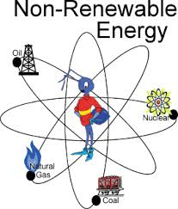
NON-RENEWABLE RESOURCES

Slide 53
PROBLEMS RELATE TO THE USE OF ENERGY RESOURCES
Fossil fuel • Global warming • Acid rains • Dangers posed by leaded fuels ,Oil spills • Water pollution caused by poorly managed coal mines • Air pollution.
Alternate energy resources • The initial cost of establishment of alternate energy generation is costlier than conventional resources. • Maintenance of these structures is difficult. • It requires more space. • Energy supply is unpredictable during natural calamities.

Slide 54
LAND RESOURCES
Land as a Resource Land area constitutes about 1/5 of the earth surface. To meet out the challenging demand of food, fiber and fuel for human population, fodder for animals and industrial raw material for agro based industries, efficient management of land resources will play critical role. Soil, water, vegetation and climate are basic natural resources for agricultural growth and development.
Land Degradation Due to increasing population, the demands for arable land for producing food, fiber and fuel wood is also increasing. Hence there is more and more pressure on the limited land resources which are getting degraded due to over-exploitation. Nearly 56% of total geographical area of the country is suffering due to land resource degradation. Out of 17 million hectare canal irrigated area, 3.4 million hectare is suffering from water logging and salinity. Soil erosion, water logging, salinization and contamination of the soil with industrial wastes like fly-ash, press mud or heavy metals all cause degradation of land.

Slide 55
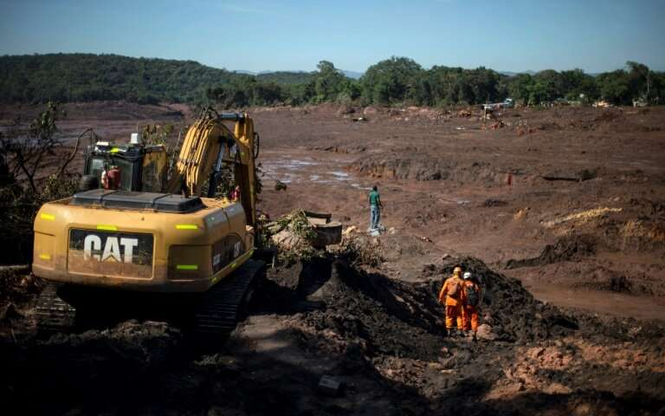
LAND RESOURCES

Slide 56
SOIL EROSION
Soil erosion refers to loss or removal of superficial layer of soil due to the action of wind, water and human factors. In other words, it can be defined as the movement of soil components, especially surface-litter and top soil from one place to another. It has been estimated that more than 5000 million tonnes topsoil is being eroded annually and 30% of total eroded mass is getting loosed to the sea .
It results in the loss of fertility. It basically is of two types, viz. geologic erosion and accelerated erosion. Various factors which affect soil erosions include soil type, vegetation cover, slope of ground, soil mismanagement and intensity and amount of rainfall. Wind is also responsible for the land erosion through saltation, suspension and surface creep. In order to prevent soil erosion and conserve the soil the following conservation practices are employed, Conservational till farming, Contour farming and Terracing
Strip cropping and alley cropping
Wind breaks or shelterbelts

Slide 57
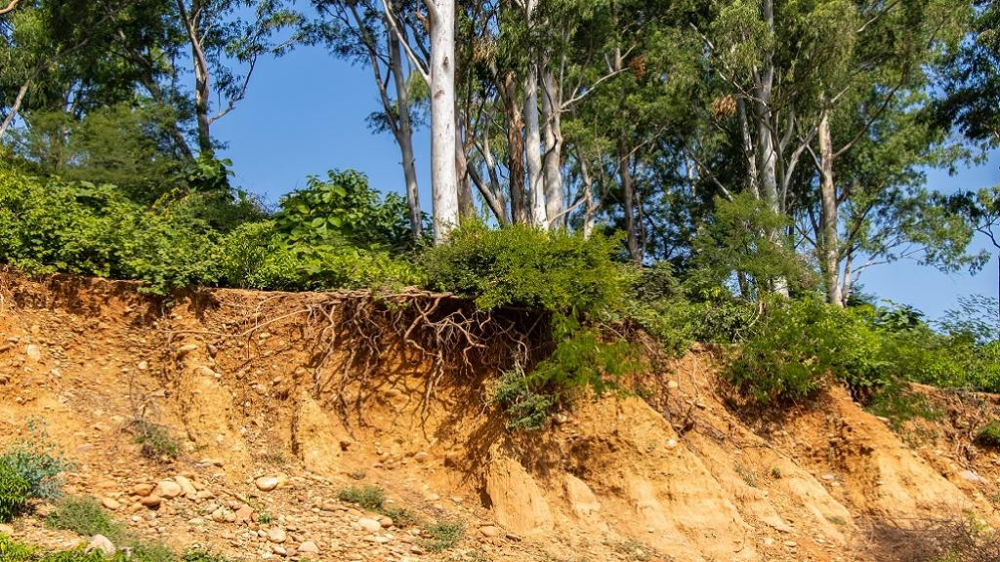
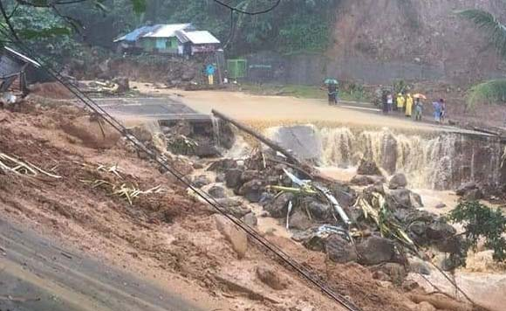
SOIL EROSION

Slide 58
Cont..,
Salinization It refers to accumulation of soluble salts in the soil. Concentration of soluble salts increases due to poor drainage facilities. In dry land areas, salt concentration increases where poor drainage is accompanied by high temperature. High concentration of salts affects the process of water absorption hence affects the productivity.
Water Logging Excessive utilization of irrigation may disturb the water balance which can lead to water logging due to rise of water table .Anaerobic condition due to poor availability of oxygen in water logged soils may affect respiration process in plants which will ultimately affect the productivity of water logged soil.
Desertification Desertification is a process whereby the productive potential of arid or semiarid lands falls by ten percent or more. Desertification is characterized by devegetation and depletion of groundwater, salinization and severe soil erosion.
Causes of desertification
Deforestation
Overgrazing
Mining and quarrying

Slide 59
Cont..,
Shifting Cultivation Shifting cultivation is a practice of slash and burn agriculture adopted by tribal communities and is a main cause for soil degradation particularly tropical and sub tropical regions. Shifting cultivation which is also popularly known as ‘Jhum Cultivation’ has lead to destruction of forest in hilly areas .It is responsible for soil erosion and other problems related to land degradation in mountainous areas.
Man Induced Landslides Human race has exploited land resources for his own comfort by constructing roads, railway tracks, canals for irrigation, hydroelectric projects, large dams and reservoirs and mining in hilly areas. Moreover productive lands under crop production are decreasing because of development activities. These factors are affecting the stability of hill slopes and damage the protective vegetation cover. These activities are also responsible to upset the balance of nature and making such areas prone to landslides.

Slide 60
CONSERVATION AND EQUITABLE USE OF NATURAL RESOURCES
Role of an Individual Natural resources like forests, water, soil, food, minerals and energy resources play an important role in the economy and development of a nation. Humans can play important role in conservation of natural resources. A little effort by individuals can help to conserve these resources which are a gift of nature to the mankind. Brief description of role of individual to conserve different types of natural resources is given below:
Roles to conserve water To minimize the evaporation losses irrigate the crops, the plants and the lawns in the evening, because water application during day time will lead to more loss of water due to higher rate of evapo-transpiration.
Improve water efficiency by using optimum amount of water in washing machine, dishwashers and other domestic appliances, etc.
Install water saving toilets which use less water per flush.
Check for water leaks in pipes and toilets and repair them promptly.
Don’t keep water taps running while they are not in use.
Recycle water of washing of cloths for gardening.
Installing rainwater harvesting structure to conserve water for future use.

Slide 61
ENERGY CONSERVATION FOR FUTURE USE
Turn off all electric appliances such as lights, fans, televisions, computers, etc when not in use.
Clean all the lighting sources regularly because dust on lighting sources decreases lighting levels up to 20-30%.
Try to harvest energy from natural resources to obtain heat for example drying the cloths in sun and avoid drying in washing machine.
Save liquid petroleum gas (LPG) by using solar cookers for cooking.
Design the house with provision for sunspace to keep the house warm and to provide more light.
Avoid misuse of vehicles for transportation and if possible share car journey to minimize use of petrol/diesel. For small distances walk down or just use bicycles.
Minimize the use air conditioner to save energy.

Slide 62
(cont..,)
Protect soil health Use organic manure/compost to maintain soil fertility
To avoid soil erosion does not irrigate the plants by using fast flow of water. Use sprinkler irrigation to conserve the soil.
Design landscape of lawn in large area which will help to bind soil to avoid erosion.
Provide vegetation cover by growing of ornamental plant, herbs and trees in your garden.
Use vegetable waste to prepare compost to use in kitchen gardening.
Promote sustainable agriculture Diversify the existing cropping pattern for sustainability of agriculture
Cultivate need based crop, Maintain soil fertility
Make optimum use of fertilizers, pesticides and other chemicals for production and processing of agriculture products
Save grains in storage to minimize the losses
Adopt post harvest technologies for value addition

Slide 63


Slide 64
EQUITABLE USE OF RESOURCES FOR SUSTAINABLE LIFE STYLE
In last 50 years, the consumption of resource in the society has increased many folds. There is a big gap in the consumers lifestyle between developed and developing countries.
Urbanization has changed the life style of middle class population in developing countries creating more stress on the use of natural resources. It has been estimated that More Developed Countries (MDC) of the world constitute only 22% of world’s population but they use 88% of natural resources.
These countries use 73% of energy resources and command 85% of income and in turn they contribute very big proportion of pollution. On the other hand less developed countries (LDCs) have moderate industrial growth and constitute 78% of world’s population and use only 12% of natural resources, 27% of energy and have only 15% of global income.

Slide 65
There is a huge gap between rich and poor. In this age of development the rich have gone richer and the poor is becoming more poorer.. This has lead to unsustainable growth. There is an increasing global concern about the management of natural resources. The solution to this problem is to have more equitable distribution of resources and income. Two major causes of unsustainability are over population in poor countries and over consumption of resources by rich countries. A global consensus has to be reached for balanced distribution of natural resources. For equitable use of natural resources more developed countries/rich people have to lower down their level of consumption to bare minimum so that these resources can be shared by poor people to satisfy their needs. Time has come to think that it is need of the hour that rich and poor should make equitable use of resources for sustainable development of mankind.

Slide 66


